Slide 1
Learning And Development

Slide 2
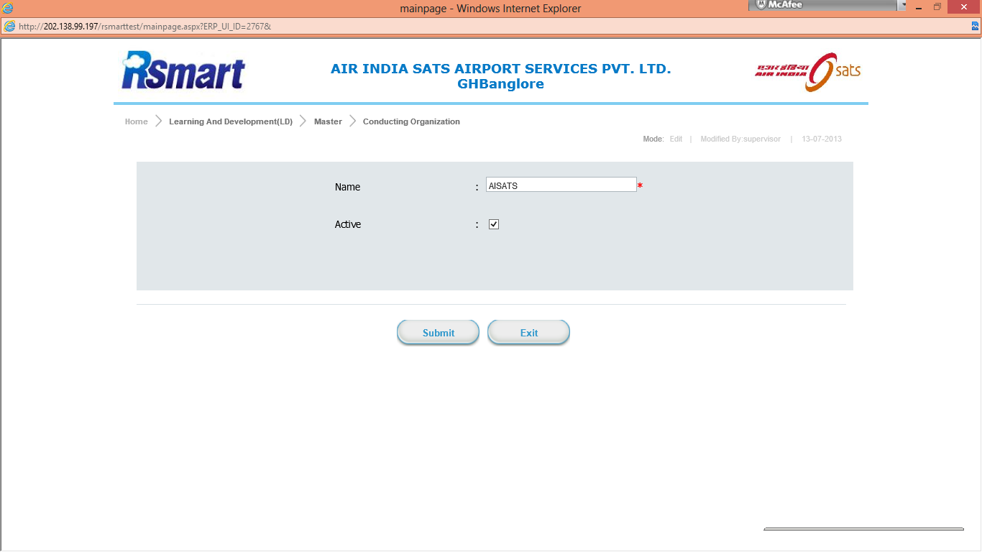
Master
Conducting Organization

Slide 3
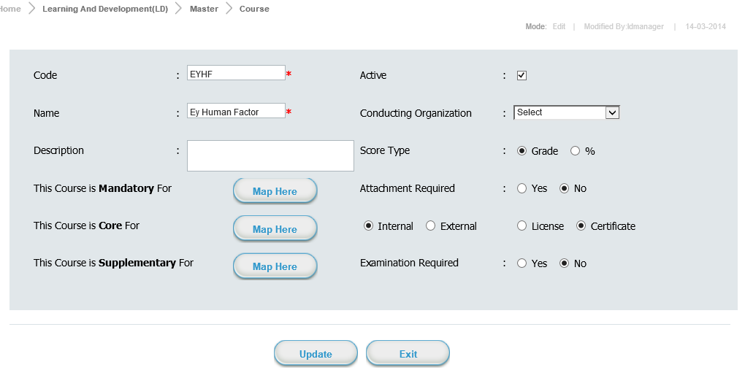
Course

Slide 4
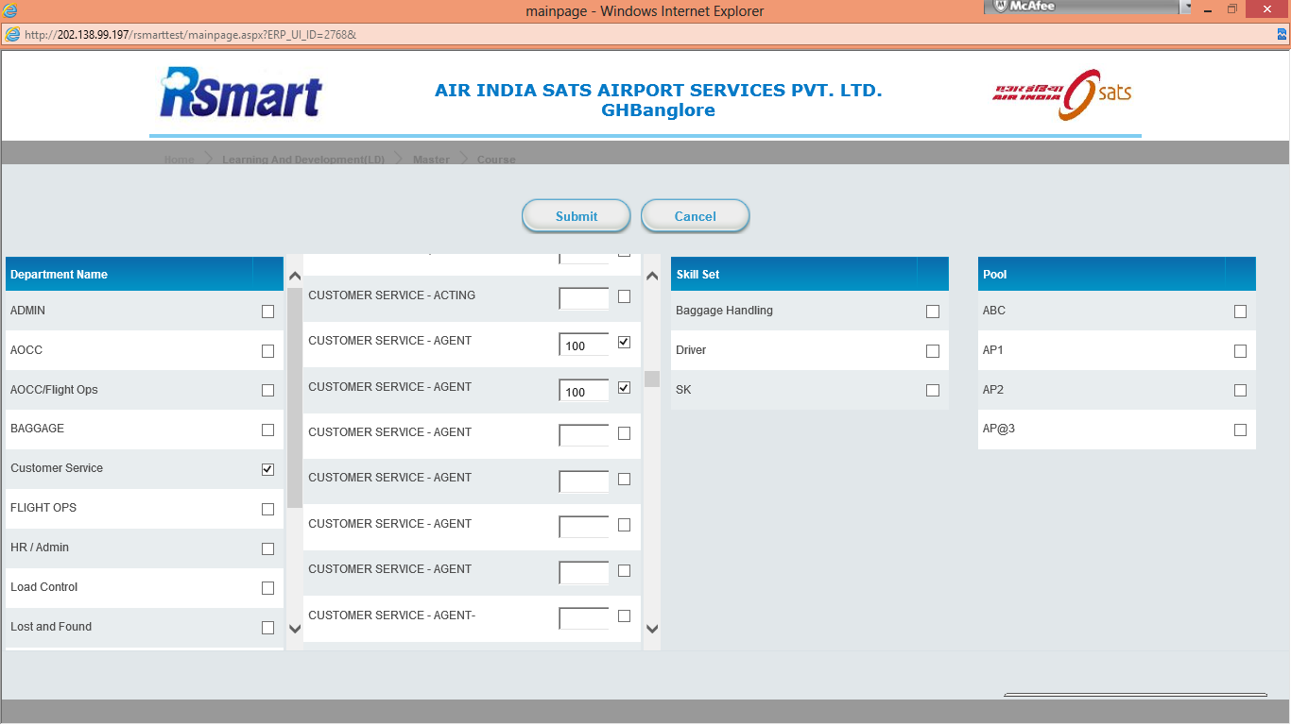
Map Here

Slide 5
Pool
Create Air line pools Company wise

Slide 6
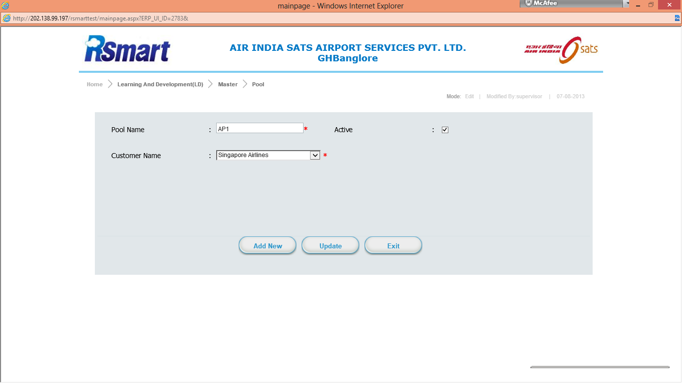

Slide 7
Certifying Agency
Create Certify agency who will provide certificate for courses

Slide 8
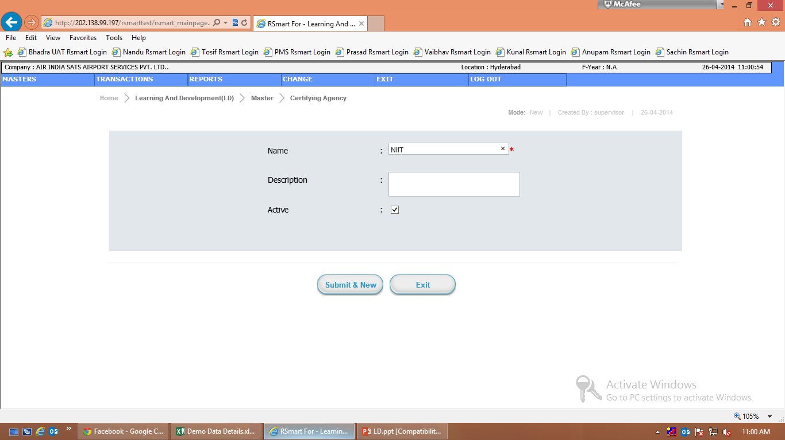

Slide 9
Course Instructor /Owner
In this master internally or externally course owner information

Slide 10
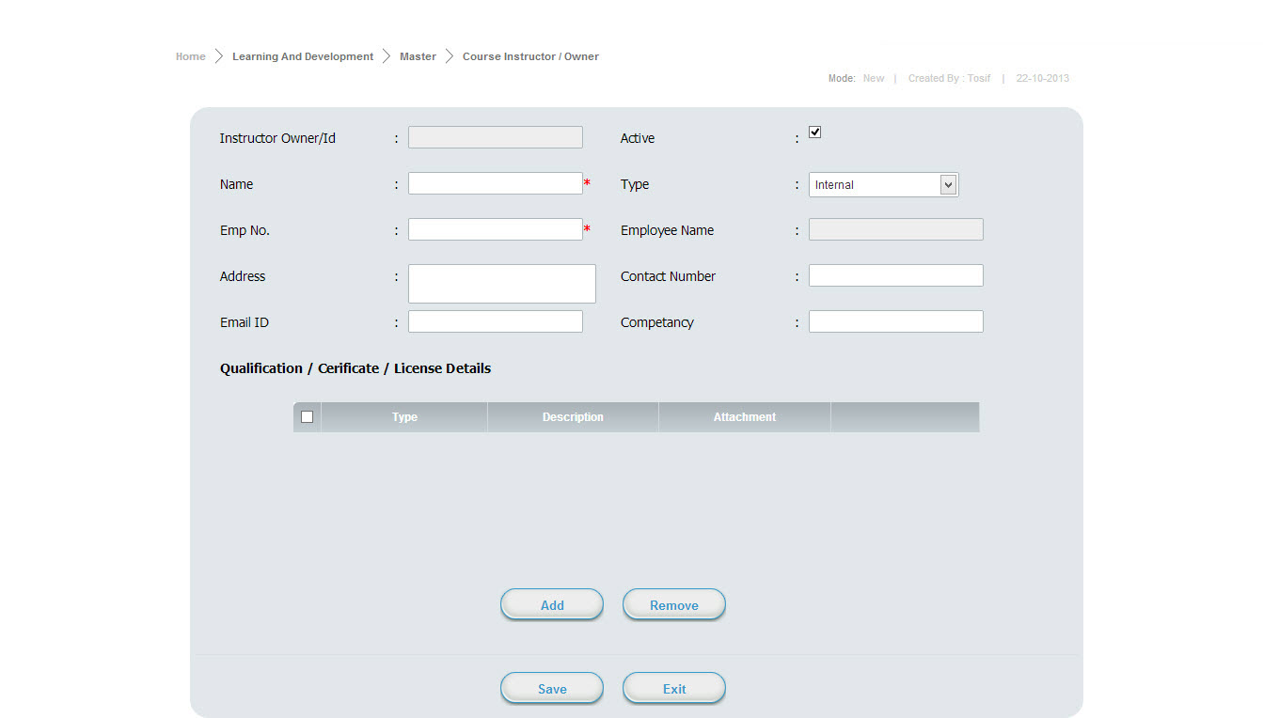

Slide 11
Training Venue
It defines venue details for conducting the courses

Slide 12
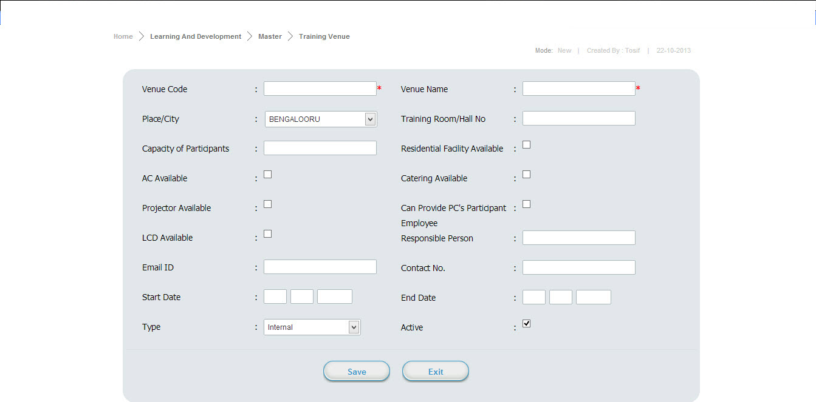

Slide 13
Transaction

Slide 14
Course Creation
This transaction create, map course to different department,designation,pool&skillset

Slide 15
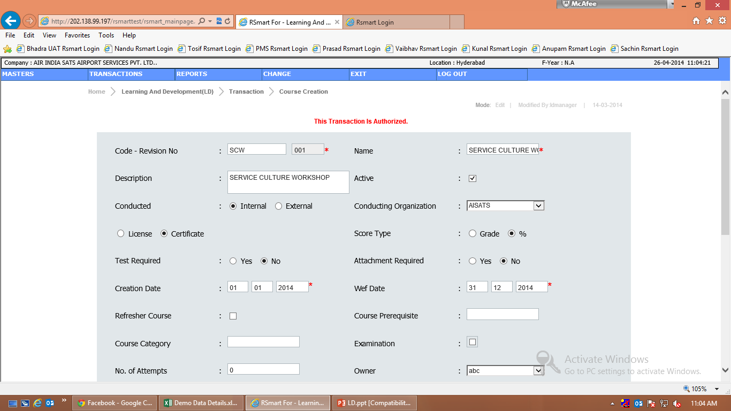
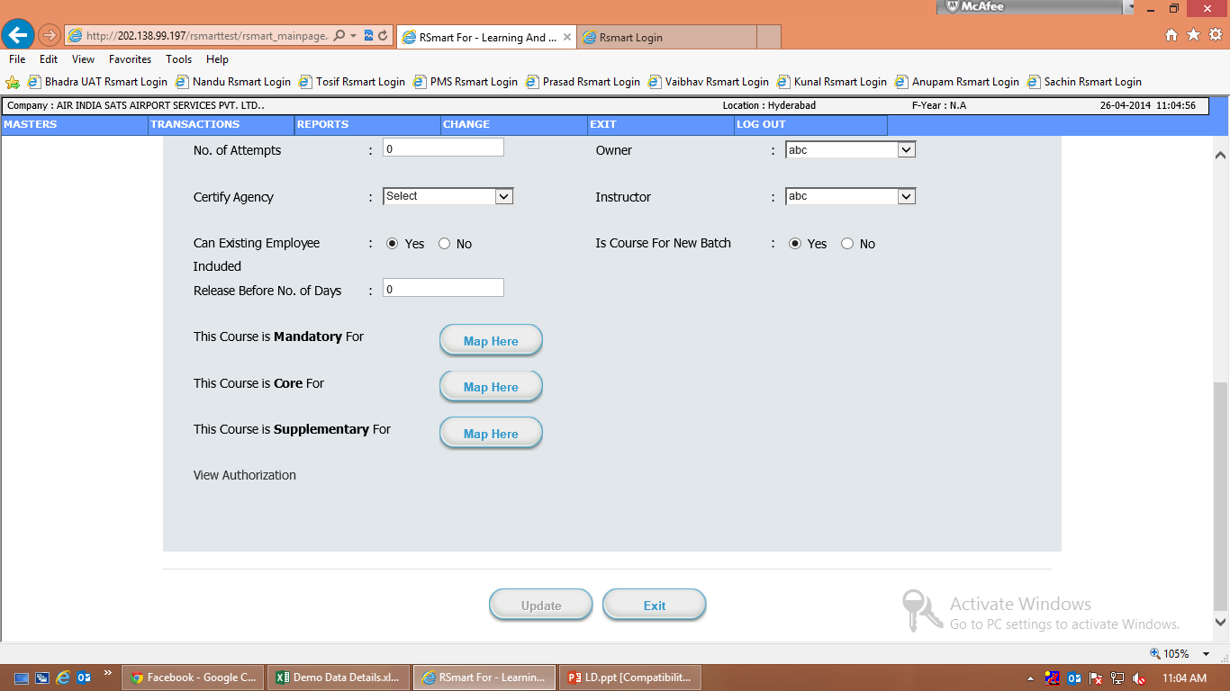

Slide 16
Map Here

Slide 17
Course Schedule
In this transaction Schedule the course location & department wise

Slide 18
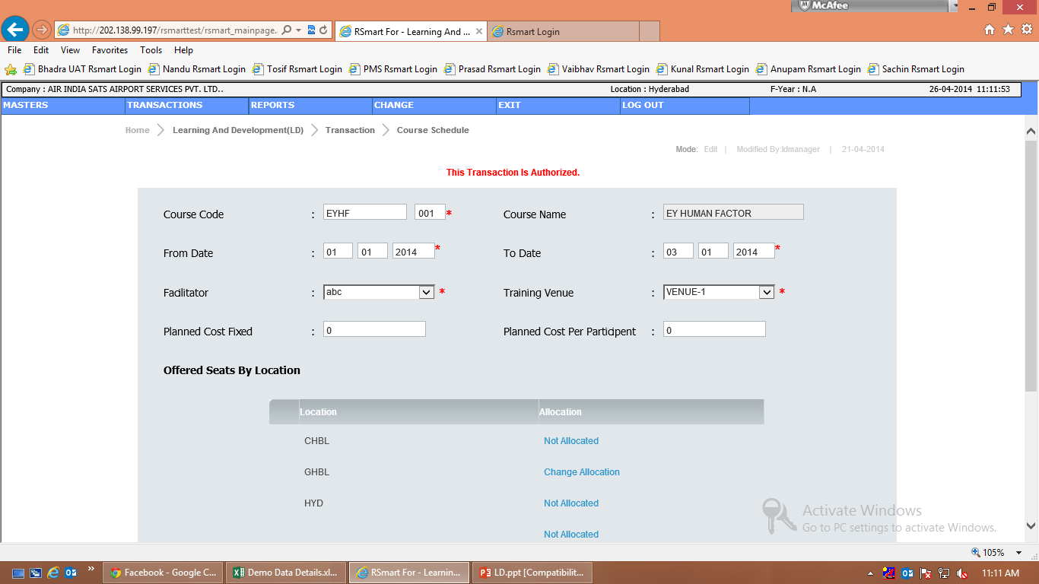
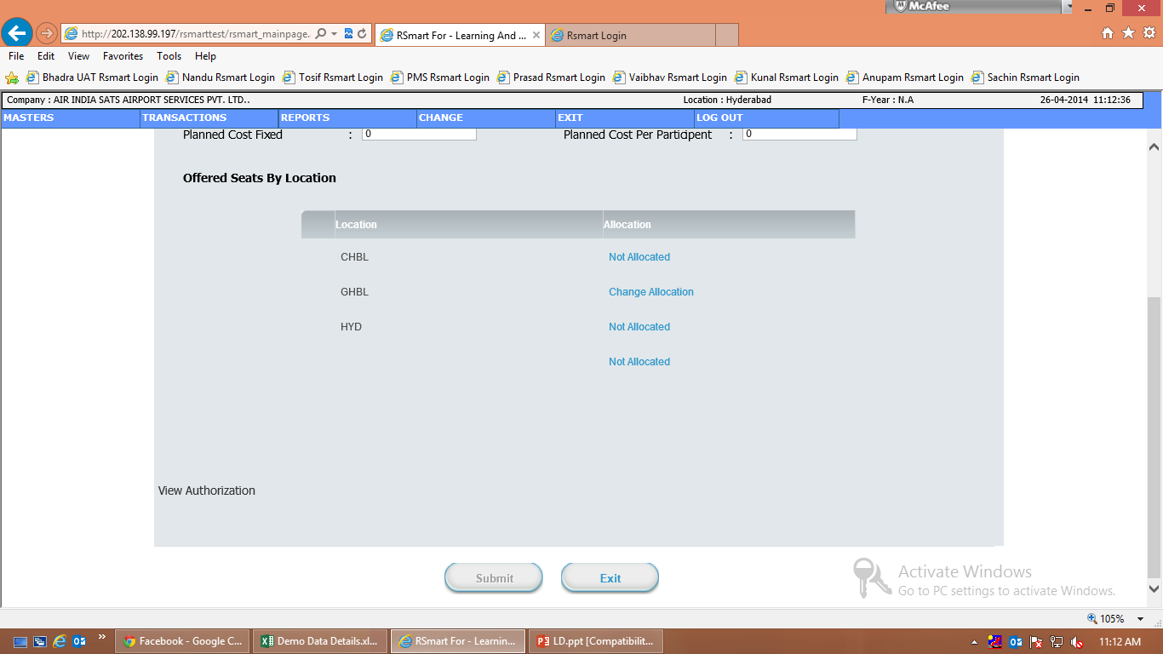

Slide 19
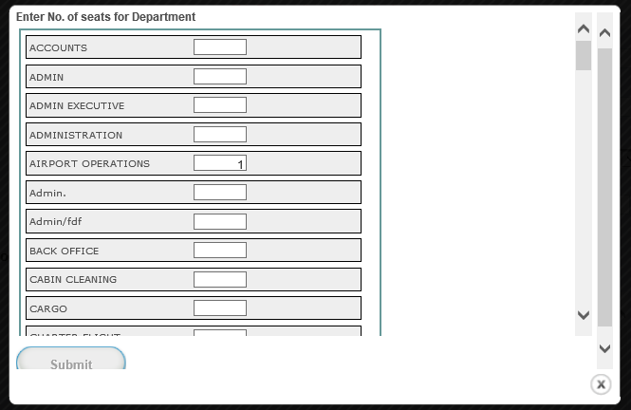
Course Schedule Allocation

Slide 20
Course Nomination
In this transaction nominate the employee particular course wise

Slide 21
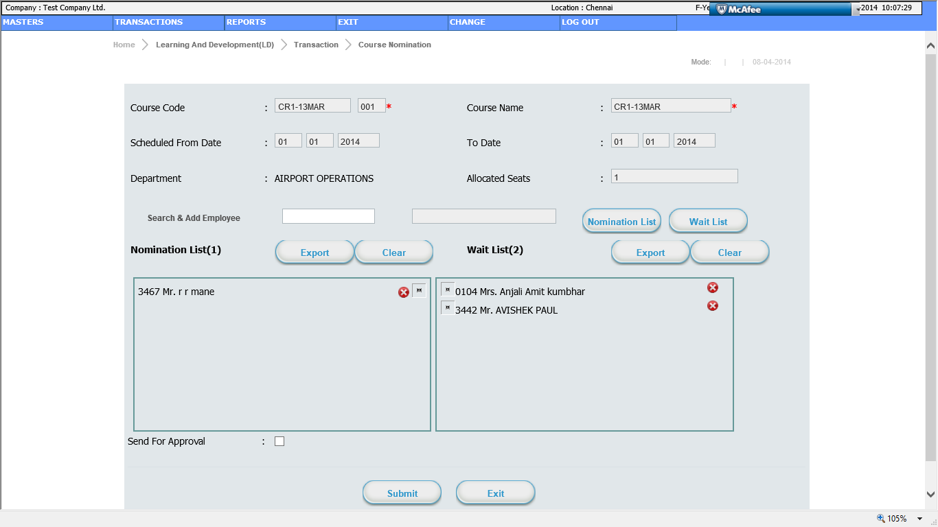

Slide 22
Course Release
In this transaction Release the courses who schedule for location & department wise

Slide 23
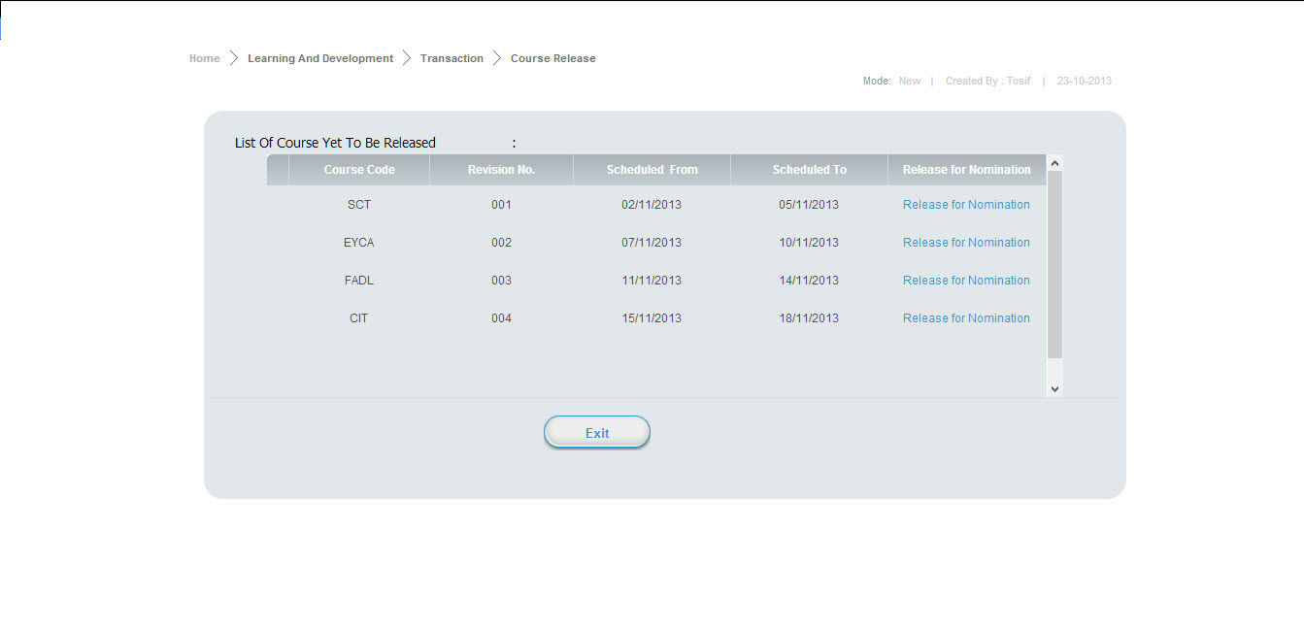

Slide 24
Course Attendance
In this transaction nominated employees attendance

Slide 25
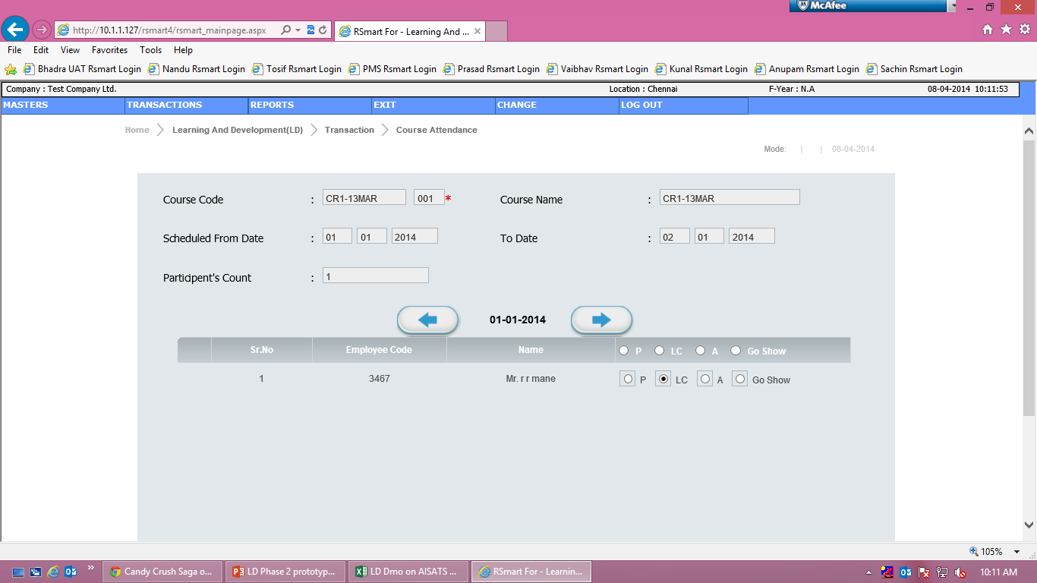
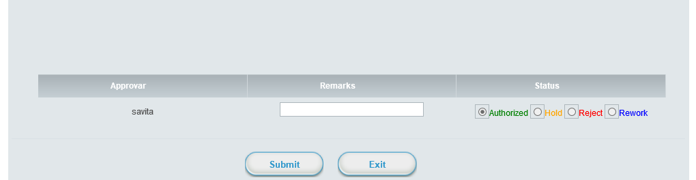

Slide 26
Course Result and Print Certificate
In this transaction after course attendace authorized result will be updated

Slide 27
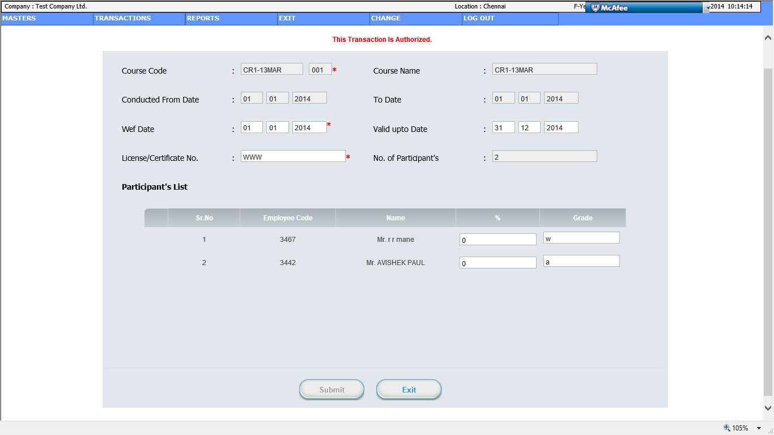

Slide 28
Reports

Slide 29
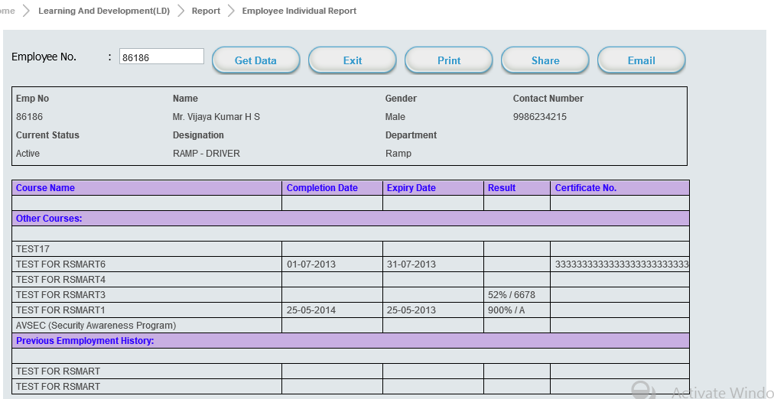

Slide 30
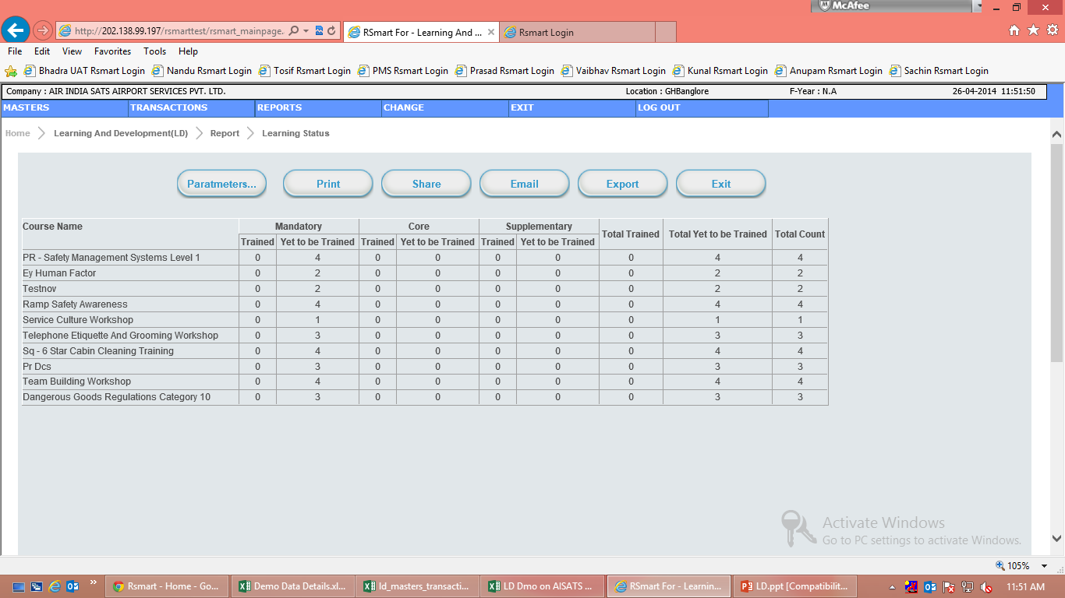

Slide 31
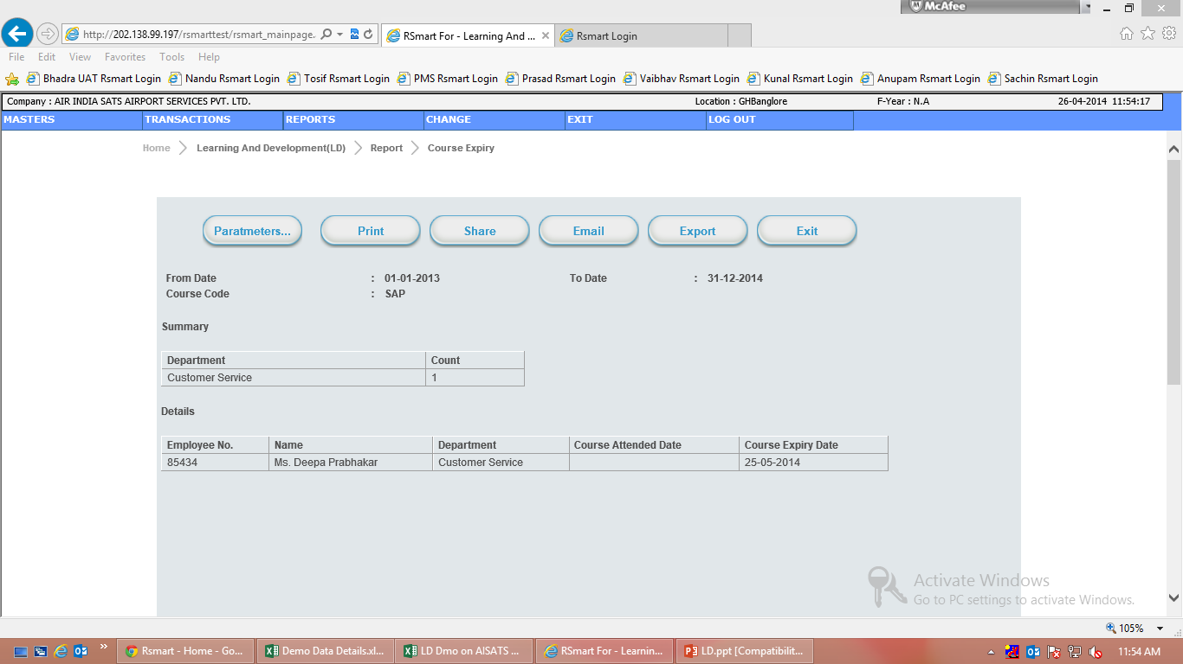

Slide 32

THANK YOU

